Slide 1
Beginning Hibernate
powered by :
Muhammad Edwin

Slide 2
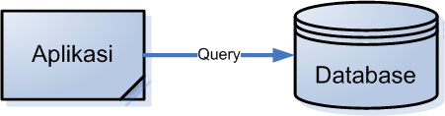
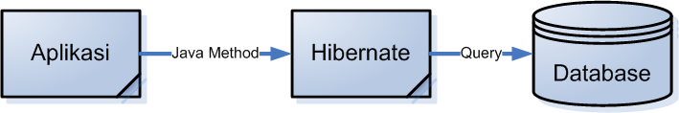
What is Hibernate?
Konsep aplikasi pada umumnya
Konsep Hibernate

Slide 3
What are the benefits of Hibernate
Database Independent
Save development and debugging time
Layered Architecture
Caching Framework
Free / Cost Effective
Code Generation Tools
Popular
Market Demand

Slide 4

A Simple Netbeans Configuration
Setup Netbeans’ Database Connection
Hibernate Configuration Wizard
Hibernate Reverse Engineering Wizard
Hibernate Mapping File and POJO
Hibernate Util.java

Slide 5
Simple Queries
session.save(Object o);
session.update(Object o);
session.saveOrUpdate(Object o);
session.delete(Object o);
session.get(Object o, Object pk);

Slide 6
More Complicated Queries
session.
createCriteria(Object o);
session
  createQuery(String o);
session.
createSQLQuery(String o);

Slide 7


